Slide 1
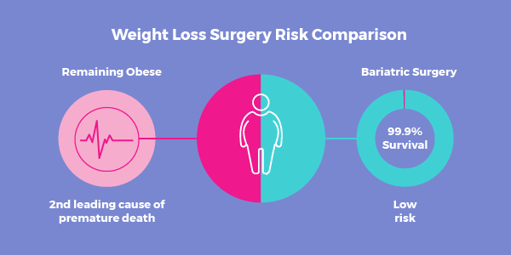
Care of the Bariatric Surgery Patient
Caitlin Coogan MSN, CPNP-AC/PC
Jillian Rekart BSN, RN, CPN

Slide 2
Background
4-6% of American youth are obese
Non-surgical treatment programs do not provide significant long-term results
Teens with a BMI > 40 die 8-13 years earlier than adults in gen population
Current law prohibits discrimination based on age, sex, race and religion- but NO LAW prohibits discrimination against the obese

Slide 3
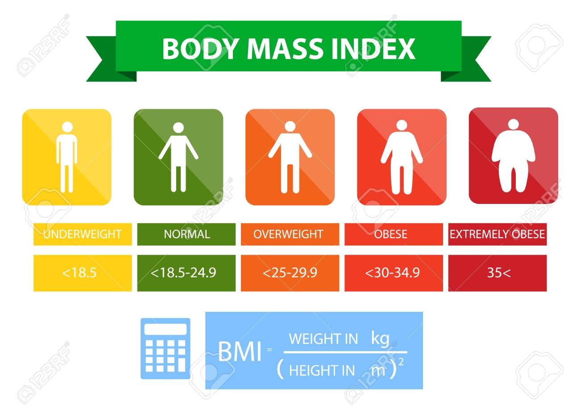
Surgical Candidates
BMI ≥ 35with obesity related conditions
BMI >40 without obesity related conditions
Medical Assessment and screening for obesity related conditions
Psychological clearance

Slide 4
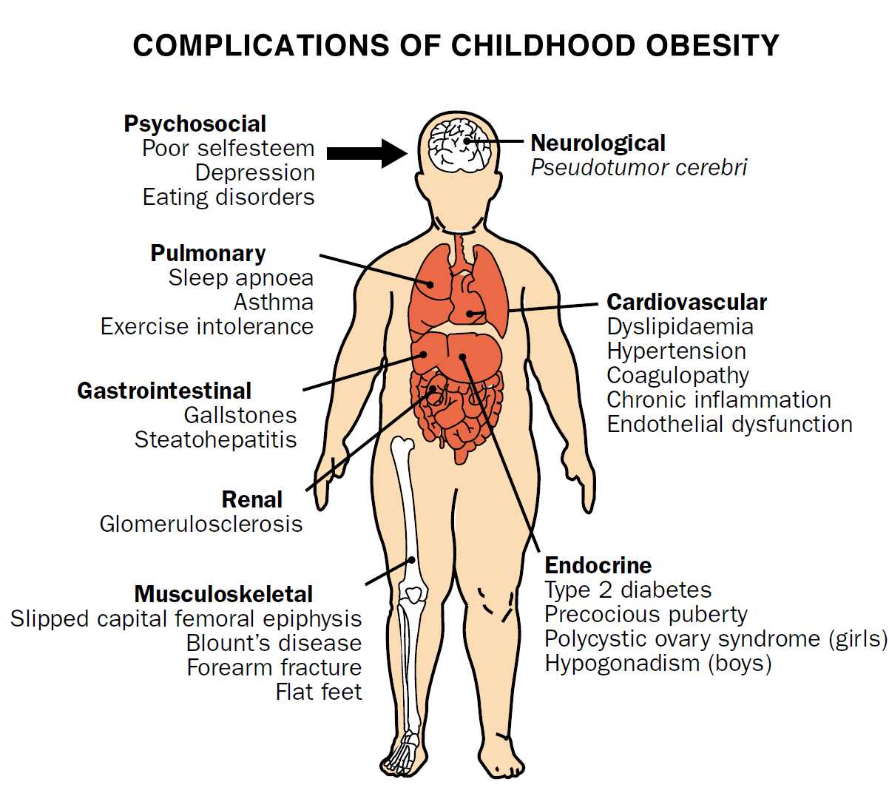
Comorbidities associated with obesity

Slide 5
Pre-operatively
Surgical Evaluation
1-12 month medical weight management assessment/program- screen for comorbidities
Psych clearance
Medical consultations for co-morbidities if applicable
POCC appointment if applicable
Fasting blood work completed during medical assessment
1-3 weeks of pre-operative diet

Slide 6
Preoperative Medications
Discuss with pharmacist/prescribing provider options for post op period
Can medications be crushed?
Is there a liquid formulation?
Can medications be stopped for a period of time after surgery (1-3 weeks)?

Slide 7
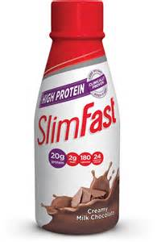
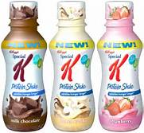
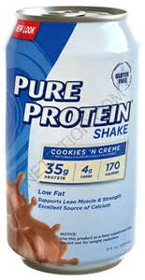
2 week Pre-op Diet
Shrinks the liver to increase surgical safety
Diet includes:
5-6 daily Protein shakes
Sugar free drinks
Limited raw vegetables
Recommended 60 ounces of water

Slide 8
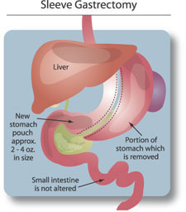
Gastric Sleeve Procedure
Most common procedure in adolescents
Removal of 80-90% of the stomach
No alteration of the intestine
Result- banana shaped stomach
CNMC has performed over
650 gastric sleeves since
January of 2010
Notes:
Updated 10/2022

Slide 9
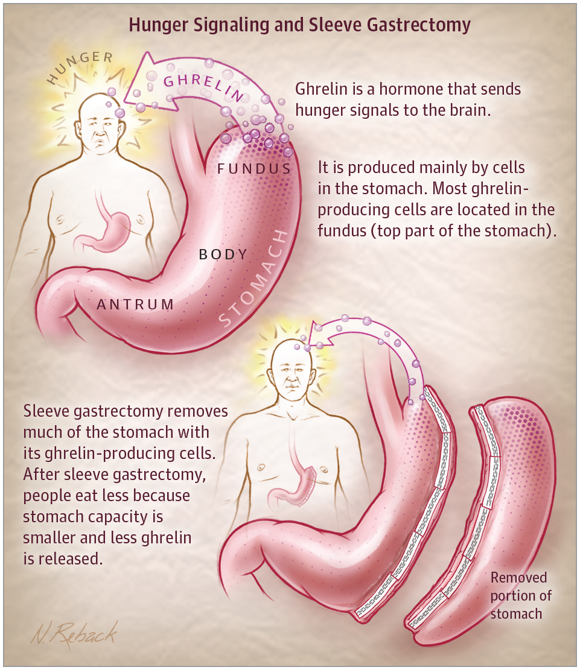
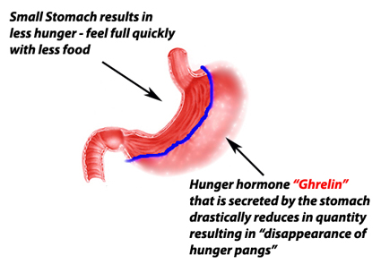
Gastric Sleeve Works

Slide 10
Advantages of Gastric Sleeve
Rapid weight loss
Less risk of nutritional deficiencies
Lower complication rates (1% vs 10% for bypass)

Slide 11
Post-operative weight loss
Average weight loss 6 months post-operative is 70 pounds
Average weight loss 1 year post-operative is 85 pounds
Some patients have significantly more weight loss depending on pre surgery excess weight

Slide 12
Disadvantages of Gastric Sleeve
Less weight loss than bypass
Possiblity of GERD
Potential leak from one long staple line
Notes:
70% of adults in US are having sleeve, 20% bypass and 10% other
95% of adolescents are having sleeve

Slide 13
Surgical Candidates:
BMI > 30 w/ obesity related condition
BMI > 35 w/out obesity related condition
Psychological clearance
Post Operative Nursing Care
No NG tube
No pills
No Straws
HOB > 30⁰
Ambulation/PT
Incentive Spirometer
SCD foot pump
Pain management
Laparoscopic Sleeve Gastrectomy
STOP and NOTIFY
Tachycardia
Decreased U/O
Nausea/Vomiting
Abdominal distension
Uncontrolled pain
Post-op Complications
Gastric Leak
Pneumonia
DVT
Dehydration
Thrush
Gallbladder disease
Notes:
1-3 are concerns while inpatient/immediately post op
4-6 more likely to happen overall but likely after 1+ week post op
Dehydration most common complication- unlikely in hospital

Slide 14
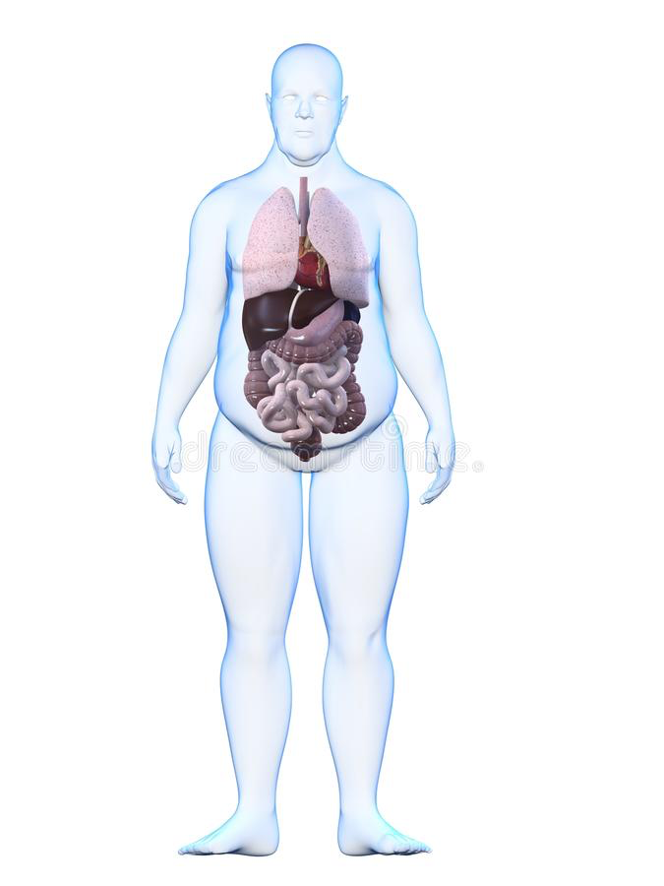
Thrush: overgrowth of bacteria in the mouth
Occurs from PPI’s immediately after surgery
Signs & Symptoms:
White lesions in mouth
Refuse to drink/eat
Treatment:
Fluconazole
Post-Op Complications
Dehydration
Common immediately post-op
Signs & Symptoms
Decreased urine output
Tachycardia
Treatment:
IVF
Encourage PO intake (30cc Q15 min)
Pneumonia: infection in the lungs
Can occur post-op if pain inhibits deep breathing and mobilization
Signs & Symptoms:
Tachypnea/SOB
Fever
Cough
Chest pain
Prevention:
Walk evening of surgery
Walk a minimum of 3x daily
IS hourly
Deep breathing exercises
Pain control
Treatment:
Oxygen
Antibiotics
Discharge Teaching:
Walk 3x daily for a minimum of 20 minutes
*Gastric Leak: gastric or intestinal contents come out of the staple lines into the abdomen
Common immediately & w/in 7 days post-op
Signs & Symptoms:
Fever
Tachycardia
Severe abdominal pain
Treatment:
Upper GI to confirm leak -> OR for repair of leak
Discharge Teaching:
Educate on s/s of gastric leak and the need to seek immediate treatment
*DVT: blood clot in a deep vein
Can occur post-op d/t pain and limited mobility
Signs and Symptoms
Extremity clot: swelling, pain, warmth, redness (red line)
Pulmonary: chest pain, SOB
Prevention:
Lovenox per protocol
Walking 3x daily
SCD leg wraps
Discharge Teaching:
Educate on s/s of DVT
Encourage ambulation and pain control
Gallbladder Disease
Common due to rapid weight loss or PMHx
Signs and Symptoms:
PO intolerance
Abdominall/back
Nausea
Treatment:
IV resuscitation
Possible lap cholecystectomy
Discharge Teaching:
Educate on s/s of dehydration
Prevention:
Ursodiol/actigall starting at 1 month post op

Slide 15
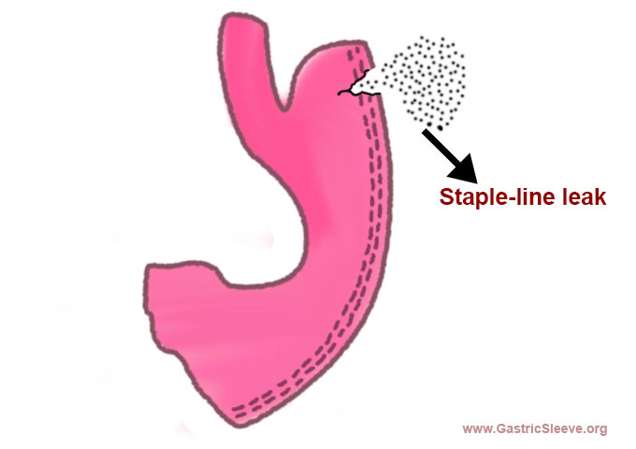
Leaks
Definition: gastric or intestinal contents come out of the staple lines
Common immediately and within the first week post-op
S/S :
- fever
- tachycardia
- severe abdominal pain
Discharge teaching
Teach s/s of leaks and the need to immediately seek treatment.

Slide 16
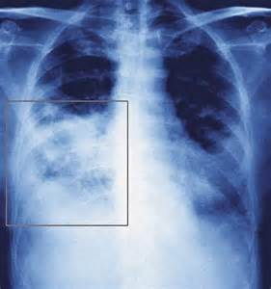
Pneumonia
Can occur post-operatively if pain prohibits deep breathing and mobilization
Prevention:
-Walk evening of surgery
-Walk a minimum of 3 x daily post-op
-Incentive spirometer hourly
-Deep breathing exercises
-Pain control
Treatment: oxygen, antibiotics
Discharge teaching:
Patients should walk 3x a day for a minimum of 20 minutes

Slide 17
Deep Vein Thrombosis (DVT)
At risk post-operatively due to pain and limited mobility
Prevention:
Lovenox per protocol
Walking 3 x daily
SCD foot wraps
S/S extremity clot:
Swelling, pain, warmth, redness (red line), warmth
S/S pulmonary embolism:
Chest pain, SOB
Discharge teaching:
-Sign and symptom recognition
-Importance of walking
-Need seek treatment
Notes:
Flip side- bleeding- why we have drastically reduced amount of patients who go home on lovenox
2 patient with PE since 2010

Slide 19
DVT Protocol
Non-Pharmacological prophylaxis
Sequential Compression Devise will be applied in the OR. SCD’s will be used when patients are in bed.
Begin ambulation day of surgery. Ambulate a minimum of three times per day
Pharmacological prophylaxis
BMI < 50 – Lovenox 40mg SQ BID starting in the OR
BMI > 50 – Lovenox 60mg SQ BID starting in the OR
Lovenox administration may be withheld on a case by case basis if:
Patients <14 years
High Risk Patients will receive a hematology consult and be discharged on 2 weeks of apixaban
Notes:
High Risk;
18+
Male
BMI >60
Hx or FHx of clots
Sedentary/Mobility limitations

Slide 20
Ambulation
Nursing unless not ambulating normally prior to surgery (then requires a PT consult)
If unsteady, consider a wheel chair following patient
Falling:
Know where to locate a lift
Practice using lifts

Slide 21
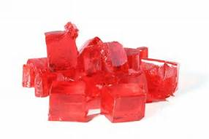
Stage I Post-Op Diet
Day 1 – Day 2 or 3
Clear liquids
Goal – hydration
Drink 4 oz (1/2 cup) every hour
If feeling full – stop drinking

Slide 22
Stage II Post-Op Diet
Day 2/3 – 2 weeks Post-OP
High protein shakes (if tolerated)
Bone Broth with collagen added
Clear drinks with protein(e.g. Gatorade zero with protein)
Non-fat plain yogurt (Greek is best) or yogurt with protein added (e.g. TwoGood brand yogurt)
Sugar free pudding (2 oz per sitting)
Sugar Free jello
Sugar free popsicles

Slide 23
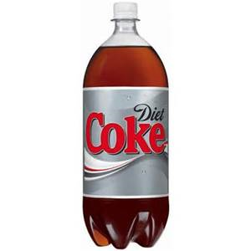
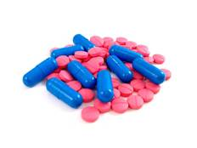
Post-Op Diet Restrictions
No carbonated beverages
No pills – all medication must be liquid
(3 weeks)
No Straws

Slide 24
Stage 3 & 4 Post-Op Diet
Stage 3
Stage 4
Starts ~2 weeks post-op
Pureed food
Minimum:
60 gm protein; 6 cups fluid
Starts 4-5 weeks post-op
Introduction of solid food
Start with high protein food

Slide 25
Discharge Teaching
Patients need to be tolerating stage I diet to maintain hydration
Goal – discharge post-op day 1-2
Follow up in clinic with surgeon/NP in 1 month
Crush all medications or take liquid for 3 weeks
Pain medicine (motrin, rarely oxy)
PPI- omeprazole capsules(prevent reflux)- open and mix with protein shake for 2-4 weeks
Ursodiol (prevent gallstones)- 3 months
Multi-vitamins daily(chewable/patch or liquid for 3 weeks)- continue taking forever
Return to school 7-14 days after surgery
Walk 20 minutes a day- 3/5 times throughout day
No strenuous/contact activity until after follow up visit

Slide 26
Discharge Teaching
Apps on smart phones that are helpful
My fitness pal
The Carrot
Lose it
Restaurant Nutrition
Calorie Counter
Spark People

Slide 27
Additional Discharge Teaching
Take Multivitamin
Separate liquids and solids by 20-30 min
Chew 20 times before swallowing
Stop eating when not hungry, full is too late
60-60-60 GOAL (60oz water, 60grams protein, 60 min exercise)
Limit caffeine or increase water intake
Protein (60g/day)- shakes/bars/powder if you are not eating enough protein from food
Pee at least 3 times daily- if not increase water

Slide 28
Bariatric Sensitivity Training
Belief About Obese Persons (BAOP) Survey
https://app.brandquiz.io/drexel-university/baops-beliefs-about-obese-persons-scale
For those taking online- your score will automatically be calculated
For those taking in class- multiply each answer by -1, add 24 to the total (scores will range from 0-48)
Notes:
Higher scores indicate belief that obesity is caused by environmental/genetic factors more so than personal habits. Lower scores indicate a belief that the individual is more responsible for their obesity.

Slide 29
Bariatric Sensitivity Training
The Facts: Why sensitivity training is SO important
31% of nurses stated that they prefer not to care for people with obesity
69% of patients with obesity said that healthcare providers were a source of stigma
Weight bias in healthcare increased over 66% in the past decade
https://www.youtube.com/watch?v=lZLzHFgE0AQ&feature=youtu.be

Slide 30
Bariatric Sensitivity Training
Bias in Education
In School Multiple forms of weight stigmatization also occur in educational settings. Students affected by obesity face numerous obstacles, ranging from harassment and rejection from peers at school, to biased attitudes from teachers, lower college acceptances and wrongful dismissals from college.
The severity of this problem is highlighted by research showing that stigma toward students affected by obesity begins very early. For example, negative attitudes have been reported among pre-school children (ages three to five) who associated peers affected by obesity with characteristics of being mean, stupid, ugly and having few friends.
Bias in education is expressed through extensive peer victimization at school, and negative attitudes by teachers, administrators and academic institutions.
Weight Bias by Peers:
Negative attitudes begin as early as preschool.
Children affected by obesity are teased by kids and chosen less as playmates.
Stigmatization continues through high school and college, where students affected by obesity are viewed as
self-indulgent, lazy and are excluded from social activities.
Peer Victimization:
At least 30 percent of girls with excess weight and 24 percent of boys with excess weight report being teased by peers at school.
Adolescents at the heaviest weight are most likely to be teased because of their weight.
Overall, as many as 63 percent of girls and 58 percent of boys report peer victimization.
Having excess weight predicts future peer victimization.
Bias by Educators:
Teachers report that students affected by obesity are perceived as:
Untidy
More emotional
Less likely to succeed at school
More likely to have family problems
Educational Institutions:
Children with excess weight are less likely to be accepted to college, despite equivalent application rates and academic achievement.
Students affected by obesity are sometimes dismissed from college because of their weight.
Notes:
www.obesityaction.org

Slide 31
Bariatric Sensitivity Training
Weight Bias in Healthcare
In Healthcare Settings
Unfortunately, weight stigma also exists in healthcare settings. Negative attitudes about individuals with excess weight have been reported by physicians, nurses, dietitians, psychologists and medical students. Research shows that even healthcare professionals who specialize in the treatment of obesity hold negative attitudes.
Bias may have a negative impact on quality of healthcare for individuals affected by obesity. Some studies have indicated that these individuals are reluctant to seek medical care, and may be more likely to delay important preventative healthcare services and cancel medical appointments. Weight bias has been reported as one reason for these negative experiences. Research indicates that 46 percent of women affected by obesity reported that small gowns, narrow exam tables and inappropriately sized medical equipment were barriers to receiving healthcare. In addition, 35 percent reported embarrassment about being weighed as a barrier to care.
Physicians:
Self-report studies show that physicians often view individuals affected by obesity as described below more often than they do individuals not affected by obesity :
Non-compliant
Dishonest
Lazy
Lacking in self-control
Weak-willed
Unintelligent
Unsuccessful
Physicians are common sources of stigma. In a study that surveyed more than 2,400 adult women about their experiences of weight bias, 69 percent of respondents reported that physicians were a source of weight bias, and 52 percent reported they had been stigmatized by a doctor on multiple occasions. Doctors were the second most frequent source of bias reported, out of a list of more than 20 possible sources of weight stigma.
Notes:
(source: Amy NK, Aalborg A, Lyons P, & Keranen L. Barriers to routine gynecological cancer screening for White and African-American women with obesity. Int J Obesity & Related Metabolic Disorders. 2006; 30: 147-155.)
(source: Puhl, R., & Brownell, K.D. (2006). Confronting and coping with weight stigma: An investigation of overweight and individuals with obesity. Obesity, 14, 1802-1815.)
www.obesityaction.org

Slide 32
Bariatric Sensitivity Training
Nurses:
Self-report studies show that nurses view individuals affected by obesity as non-compliant, overindulgent, lazy and unsuccessful. Studies of self-reported attitudes among nurses indicate that:
31 percent “would prefer not to care for individuals affected by obesity”
24 percent agreed that individuals affected by obesity “repulsed them”
12 percent “would prefer not to touch individuals affected by obesity”
Psychologists:
In studies comparing beliefs about individuals affected by obesity versus “average” weight individuals, psychologists ascribe the following attributes to clients affected by obesity:
More pathology
More severe psychological symptoms
More negative attributes
Worse prognosis in treatment
Quality of Care:
Individuals affected by obesity are also more likely to have the following challenges with quality of care:
Fewer preventive health services and exams
Less access to cancer screening tests, such as pelvic exams and mammograms
More frequent cancellation or delay of appointments
Less time spent with the physician, less intervention and less discussion with the physician

Slide 33
Resources
Patient and Family Handbook:
S:\SHAREVOL01\Obesity Institute\Verification prep\bariatric guidelines\Patient and Family Surgery Education Book final.docx
Caitlin Sherman NP
Evan Nadler MD- Director of Bariatric Surgery
Nazrat Mirza MD- IDEAL Clinic Director
Christy Bock RD- IDEAL dietician
Notes:
Thomas, S. A. & Lee-Fong, M. (2011). Maintaining dignity of patients with morbid obesity in the hospital setting. Bariatric Times, 8(4), 20-25.
Garcia, J. T., Amankwah, E. K., & Hernandez, R. G. (2016). Assessment of weight bias among pediatric nurses and clinical support staff toward obese patients and their caregivers. Journal of Pediatric Nursing, 31, e244-e251. doi: 10.1016/j.pedn.2016.02.004

