Slide 1
Insurance Approval for MBS
Jeff Zitsman, MD
MSCHONYP
APSA AMS Committee Monthly meeting
10 Sept 24

Slide 2
No financial disclosures

Slide 3
Insurance management
Picking the appropriate patient
Best shot first
Appeals & beyond

Slide 4
INSURANCE PAYMENT FOR ADOLESCENT
LAPAROSCOPIC GASTRIC BANDING--IT ISN’T EASY
BECOMING LEAN
105 consecutive adolescents for LAGB
  Specialist letters, labs, studies
  Visit documentation
44 approved (42%)
  40 Additional material requested
    Additional testing 6
    Case letters 16
32 more approved (68%)
  Additional letters, Peer-to-peer, letter from lawyer; 1 self-pay
24 more approved (96%)
  2 denied
  2 found that insurance did not cover MBS
Zitsman, JL. Presented at ASMBS Obesity Week, 2010

Slide 5
Picking the appropriate patient
BMI and/or 95th%ile measurements
Comorbid conditions
Criteria of the policy of the insured
  Is MBS covered? Has it been carved out?
    Bring this up EARLY before the patient progresses through the program!
  What evaluations are needed?

Slide 6
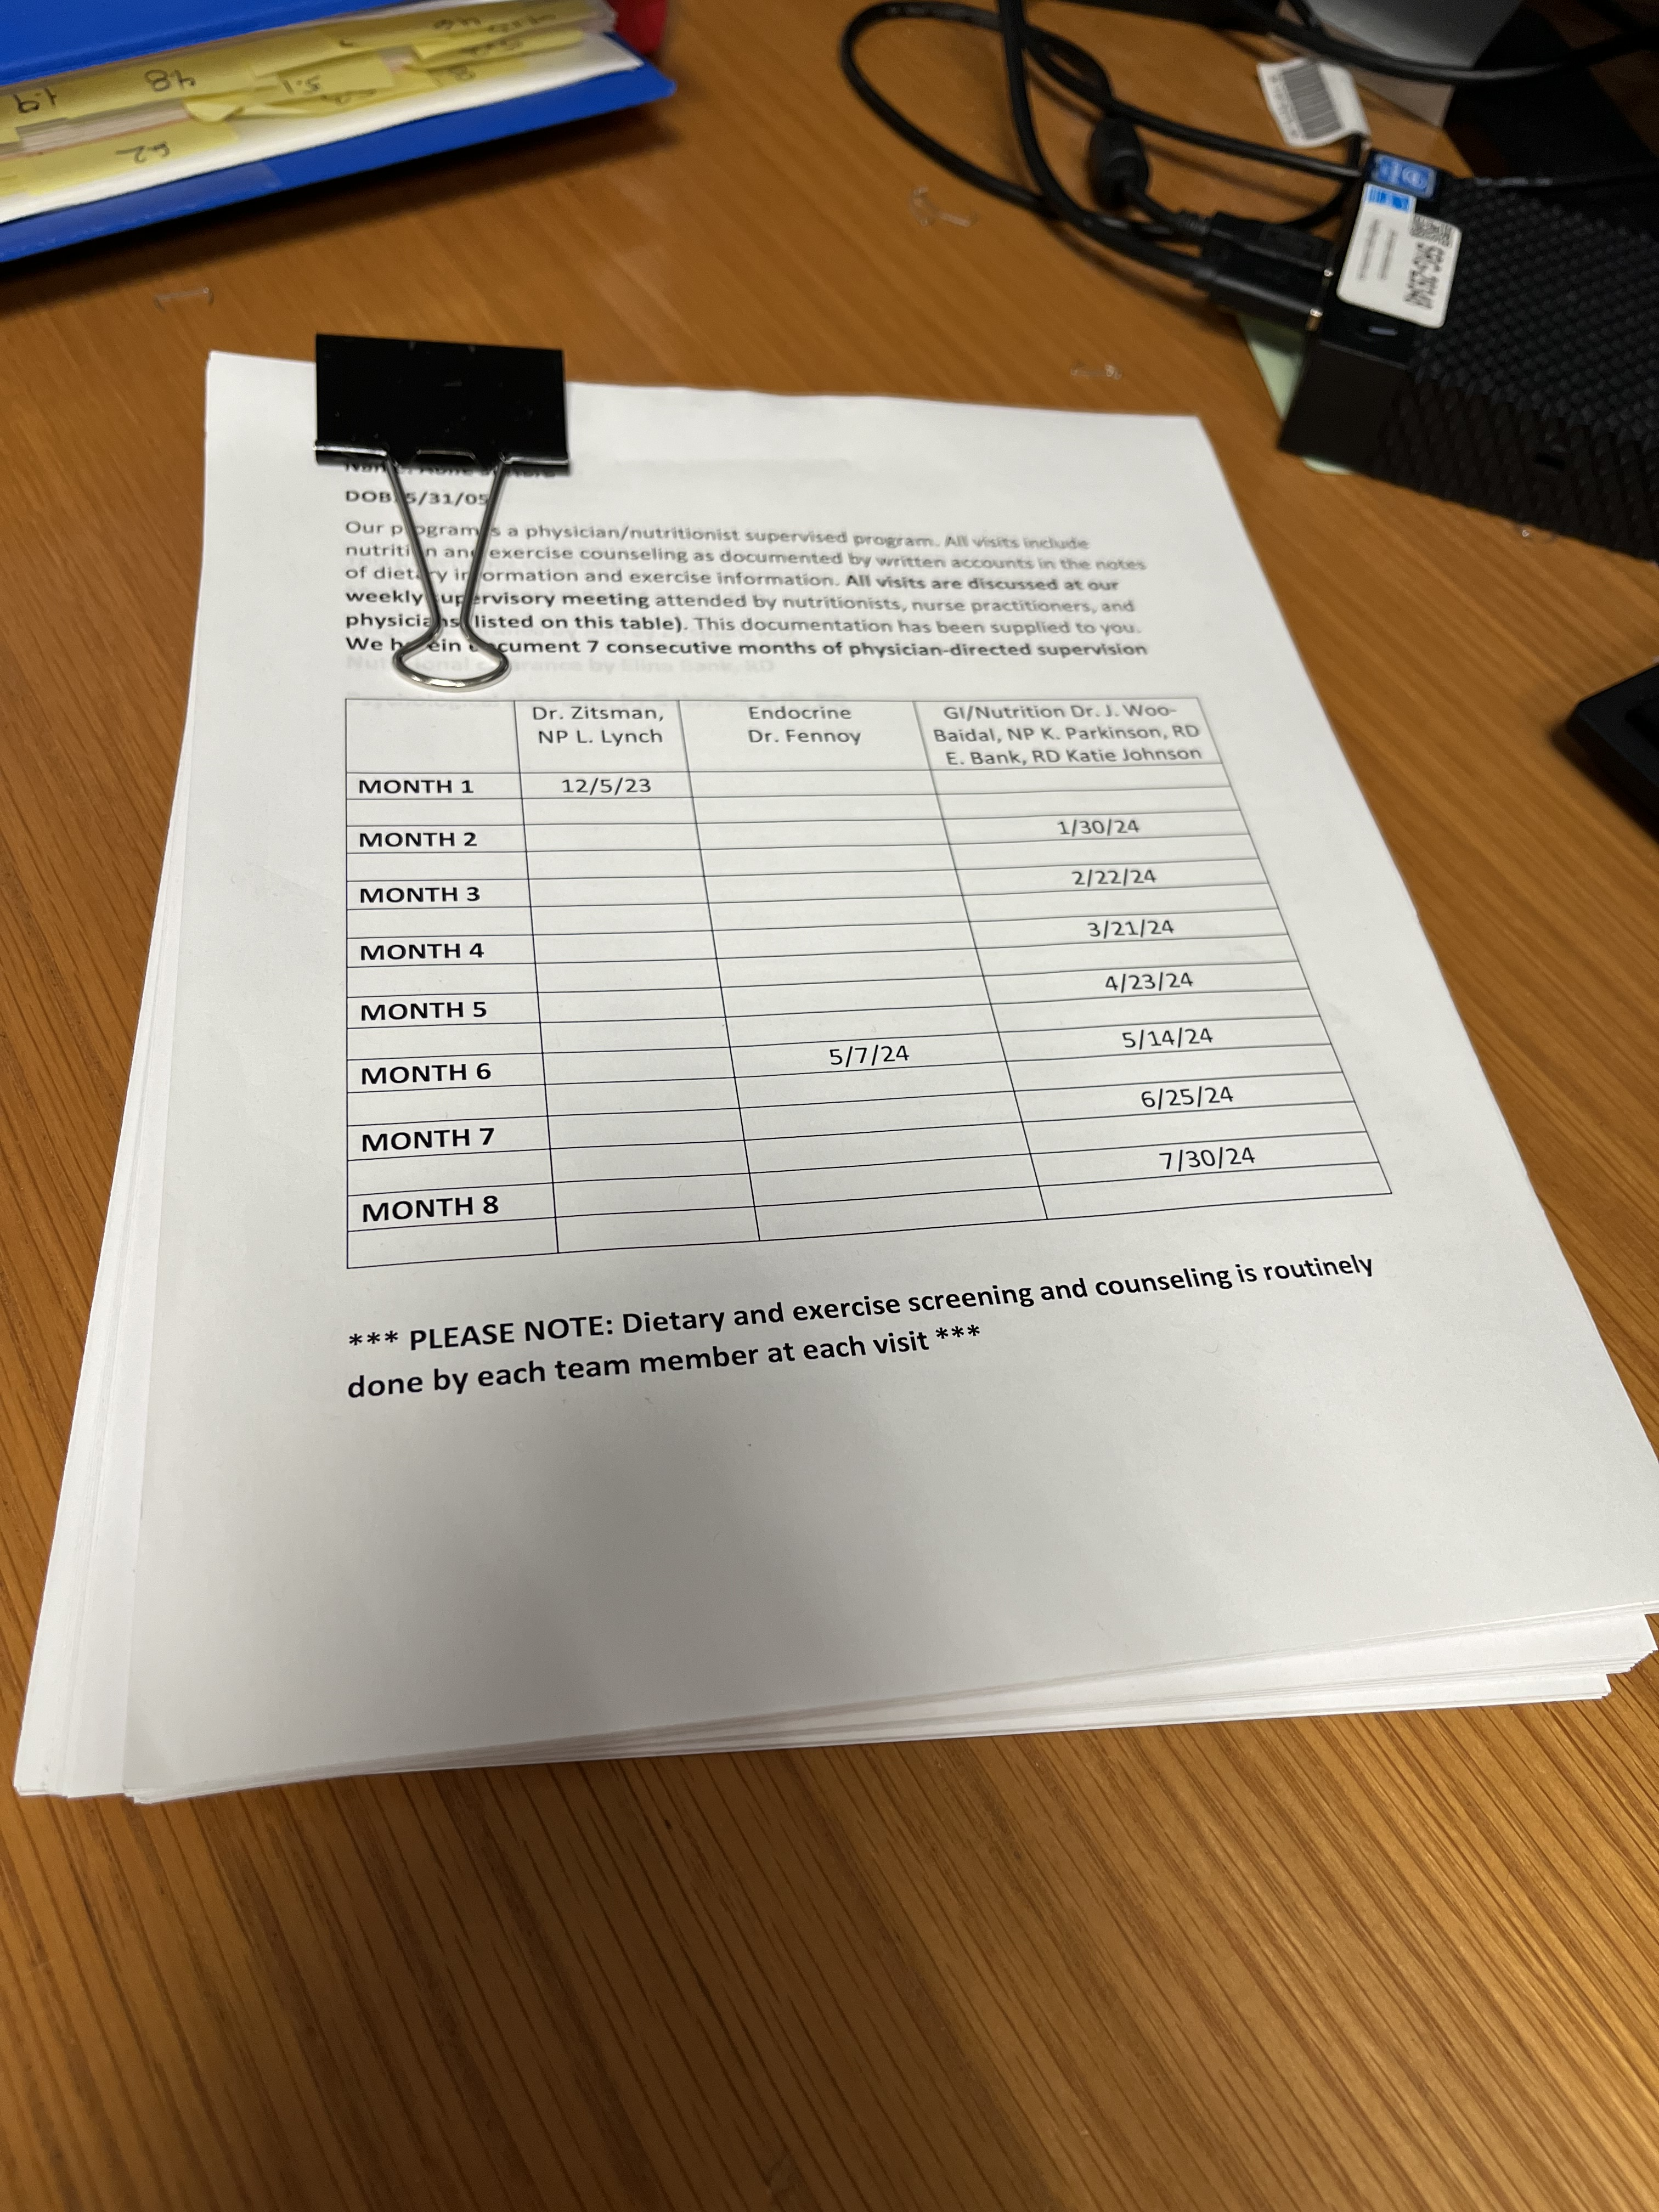
Initial application for approval
Docs faxed to insurance (90-200+)
Dates of visits (surgeon, GI nutrition, endocrine, psych)
  Cover sheet table of dates of visits
  Letters from surgeon, medical director, mental health evaluator, nutritionist
  All visit notes from the above
All testing
All imaging
All labs
Possibly supplemental letter from LMD

Slide 7
Initial application for approval
Keep record of receipt
Keep packet together until approved
Allow a MINIMUM of 2 weeks (may be
shorter if >18 yr)
Call after 1 week for status update
IF URGENT, call first and speak to
nurse manager

Slide 8
Initial application outcome
Surgery approved:
  Written (printed) denial sent to family/facility/surgeon
Surgery approved but EGD part of the bundle
Surgery approved as 23-hr admit
  Accept and document need to stay longer if applicable (e.g., inadequate PO intake, pain)
Request for additional document (e.g., medical director letter, nutrition visits, drug screen)—usually has been part of package sent
Request for repeat of remote testing (1 yr)--rare

Slide 9
Initial application denied
Written (printed) denial sent to family/facility/surgeon
Expect family to contact you, upset
Be confident; advised that there will be more work to be done
Peer to peer
  Have the faxed record with you
  Have the EMR open
  The reviewer is not the enemy. They are matching what they see with their criteria for approval
  If you can identify the reason(s) for denial from the letter sent, be prepared to rebut them with evidence
    Example: no documentation of 6 months consecutive visits (help them find it)

Slide 10
Initial application denied
Peer review does not approve-
  You can ask for a specialty specific peer reviewer, e.g., a bariatric and metabolic surgeon
  You can ask for an outside specialty reviewer
Family initiated appeal
  Sometimes required by the policy. You can guide them
  Obtain additional support from the pediatrician
Letter from you indicating that insurance company is denying standard acceptable medical and surgical care in your expert opinion. Include literature (ASMBS guidelines, AAP GCP summary)

Slide 11
All appeals unsuccessful
Family can seek help through employer’s HR
Family may contact a lawyer to file suit against the insurance company
Self pay with reduced fees
  Hospital expenses
  Anesthesiologist
  Surgeon
Medication

Slide 12
INSURANCE PAYMENT FOR ADOLESCENT
LAPAROSCOPIC GASTRIC SLEEVE
100 consecutive adolescents for SG (7/2021-6/2024)
  Specialist letters, labs, studies
  Visit documentation
95 approved (95%)
3 approved (98%)
  Missing documentation
  <5% peer-to-peer
2 denied
  Age criteria
THE IMPACT OF PUBLISHED DATA!!!!!

Slide 13
Summary
Make sure the patient meets criteria and that the insurance covers their surgery
Send ALL of the necessary documentation and keep handy to resend
Resend if they say something is absent
Work with the P2P person – they will often suggest how to escalate
Maintain dialogue with the family – confidence and patience
Legal action as a last resort before self-pay

