Slide 1
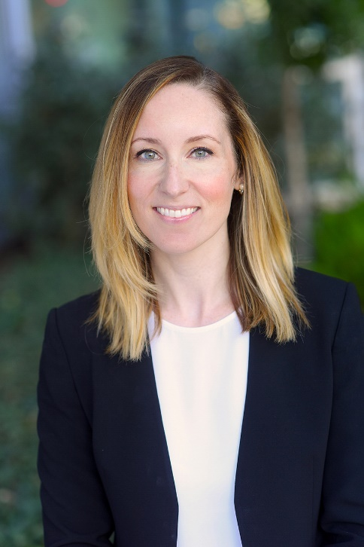
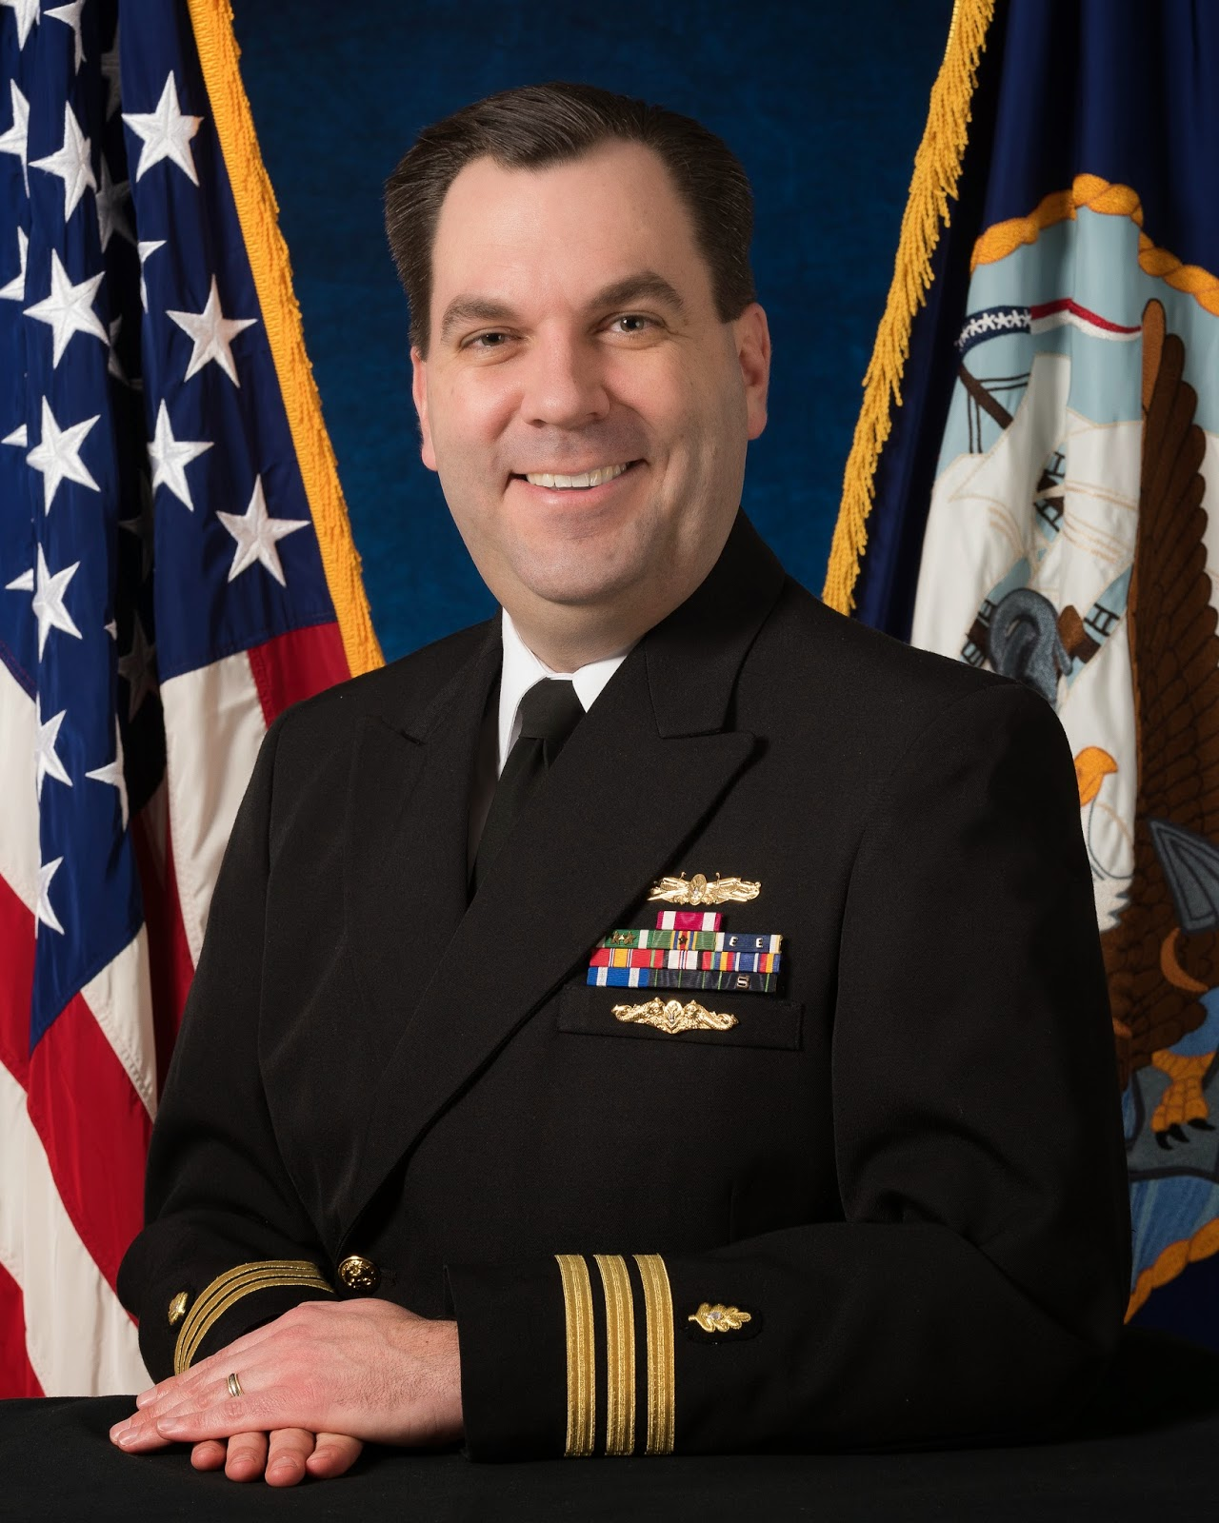
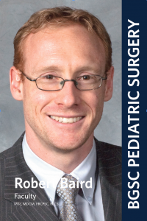
Outcomes & Evidence-Based Practice Committee
Lorraine Kelley-Quon
Chair
Robert Ricca
Vice Chair
Robert Baird
Ex-Officio

Slide 2
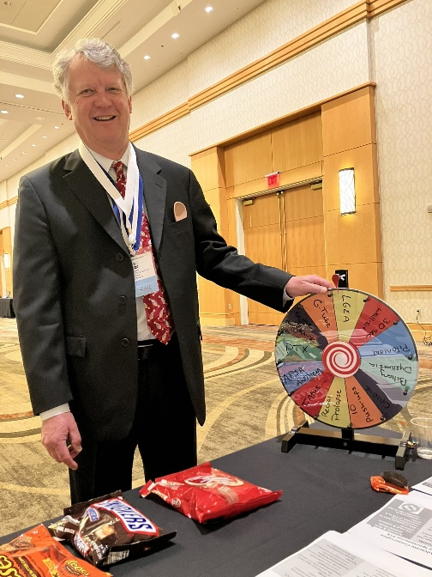
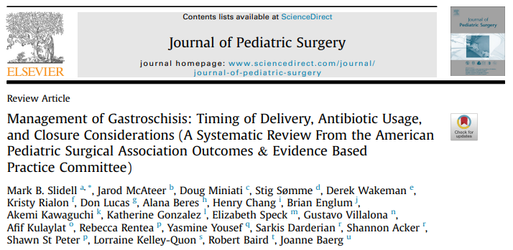
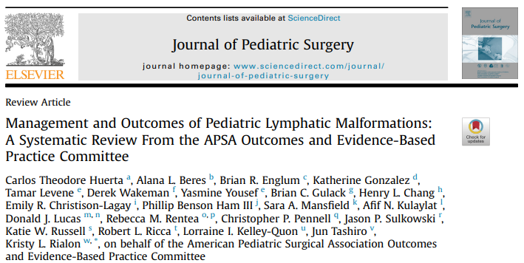
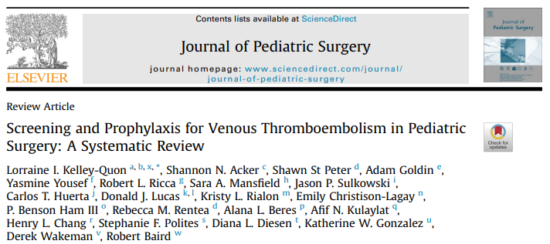
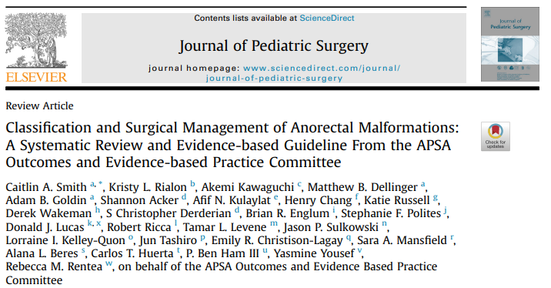
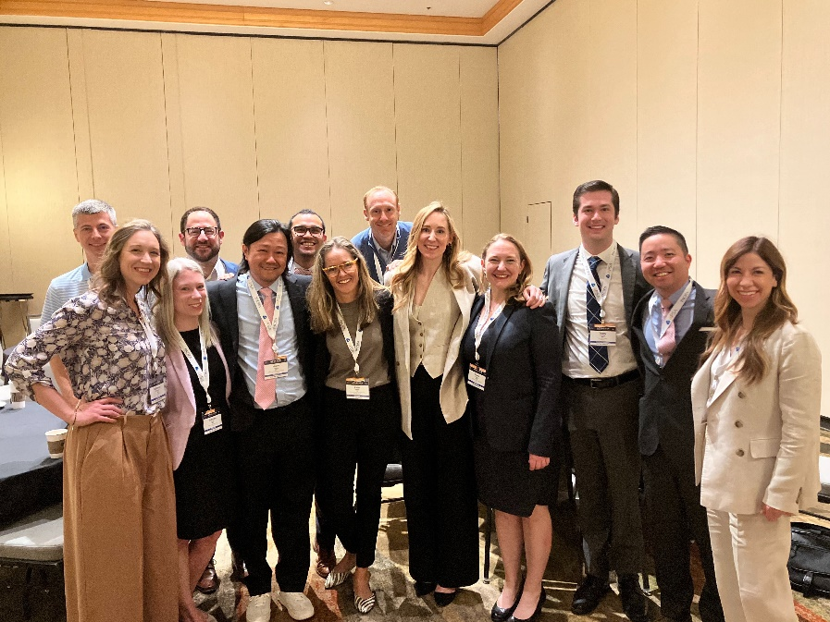
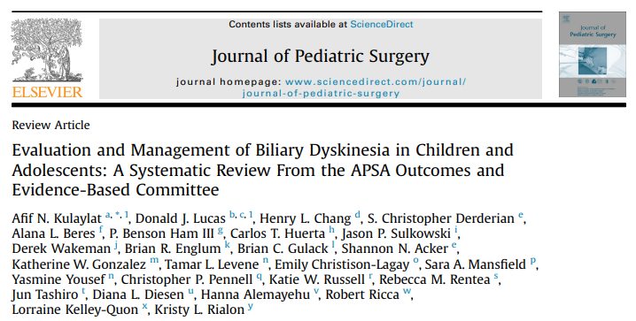
2024 Successes

Slide 3
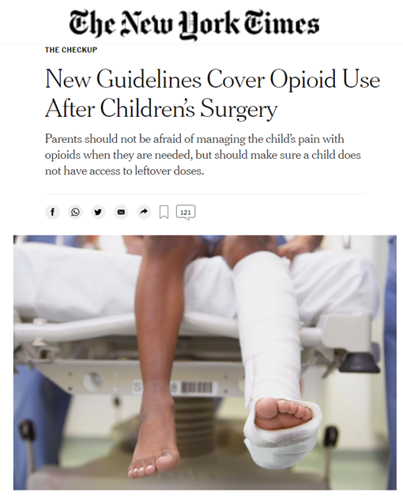
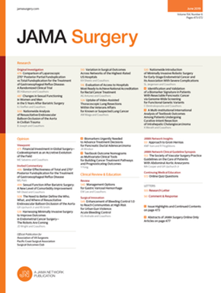
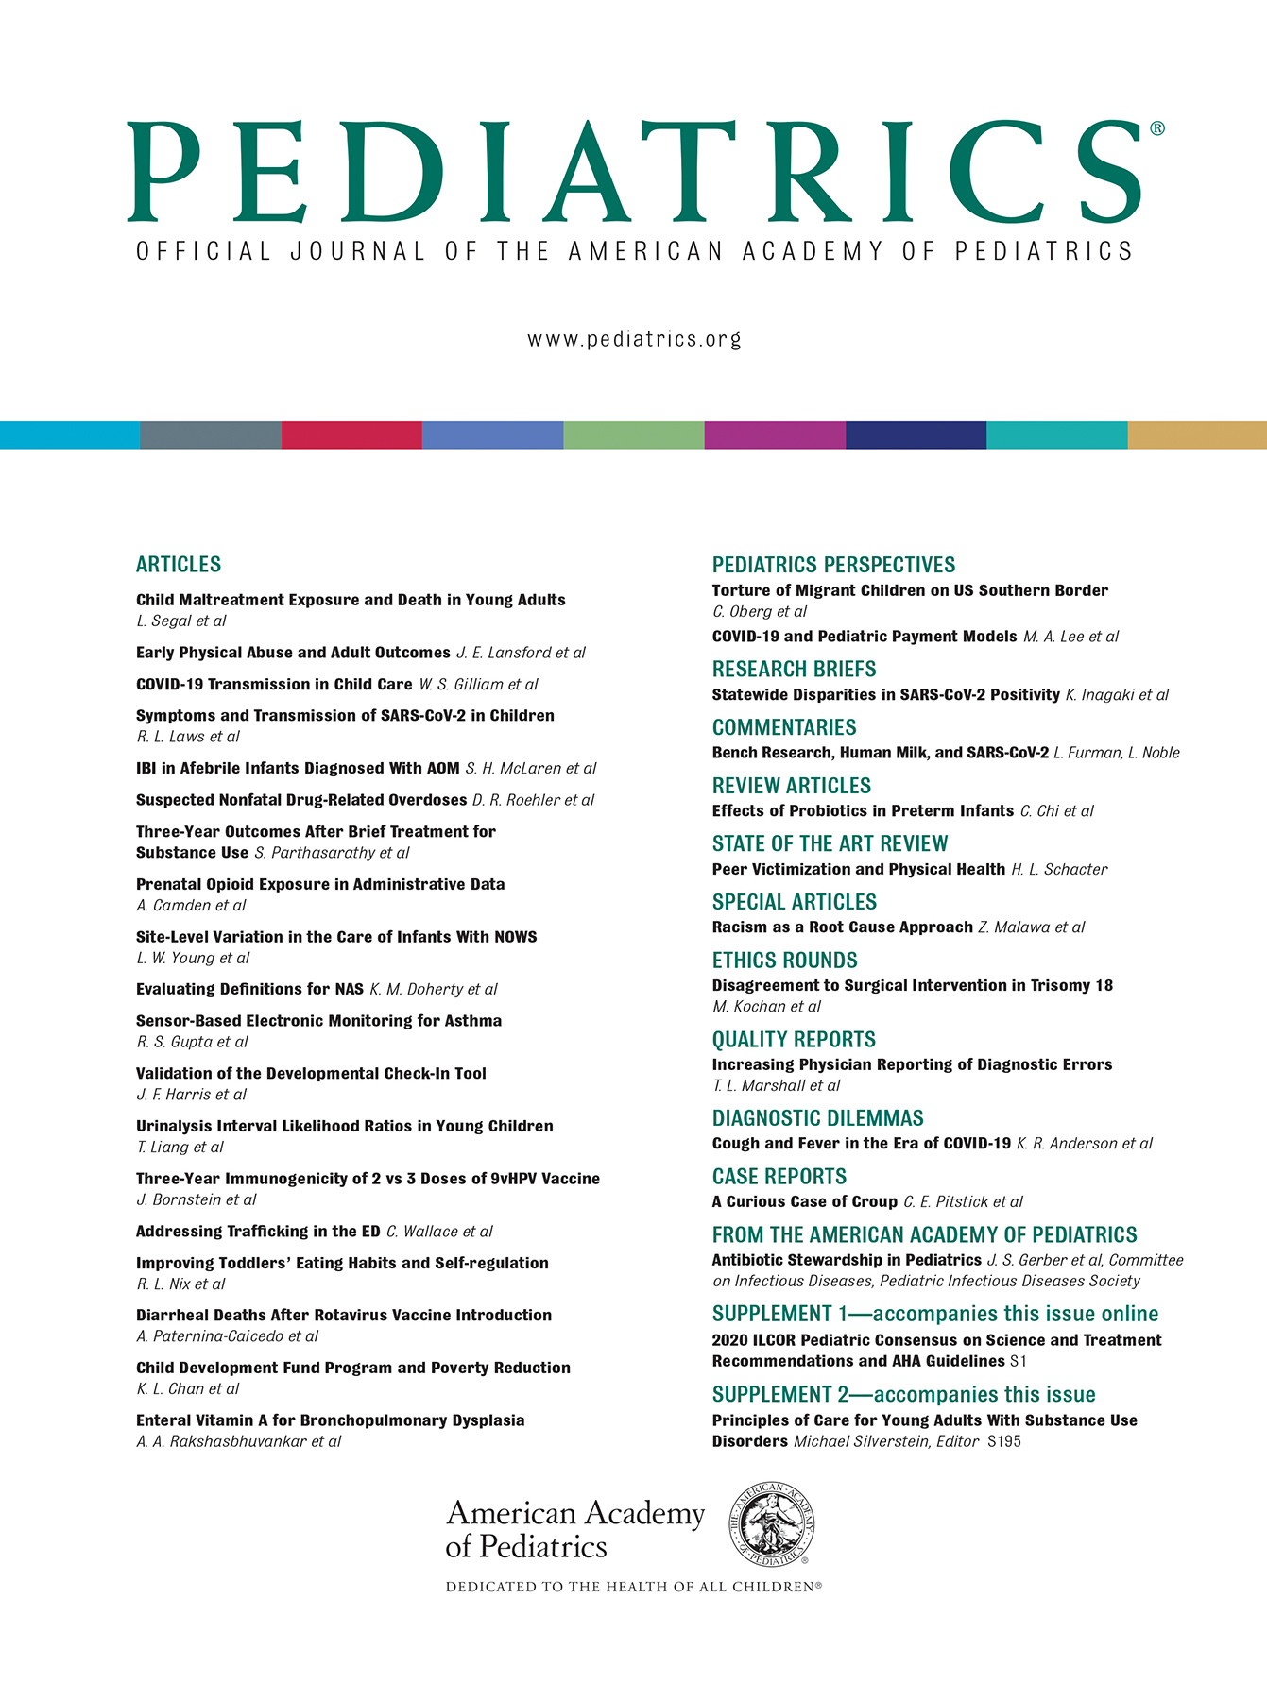
Past successes

Slide 4
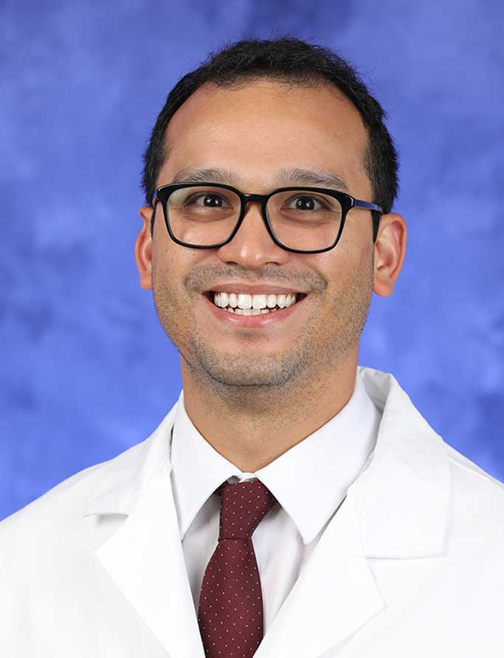
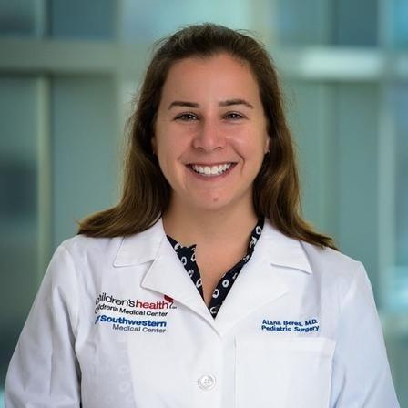
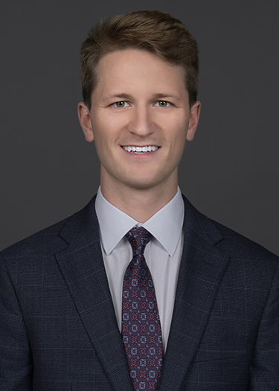
Present Work - Subcommittees
Afif Kulaylat
Survey + Algorithms
Alana Beres
E-Blasts → Articles of Interest
Matthew Hey
IT/Social Media
Twitter/X: @APSA_Outcomes

Slide 5
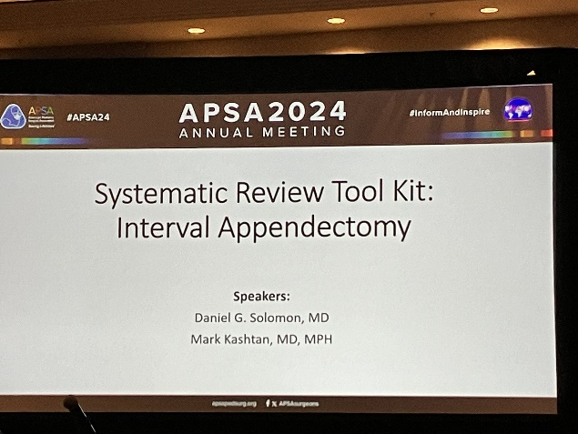
Future Directions/Needs
Current Literature Reviews
Guidelines for Radiation Stewardship in Appendicitis
Joint sessions with QI, Breakouts at annual meeting
ARM
Transition to Adult Care
Interval Appendectomy
Adolescent Breast Masses
New Ideas!!!
Adolescent Inguinal Hernias
Firearm screening vs EA screening vs Sequestration

