Slide 1
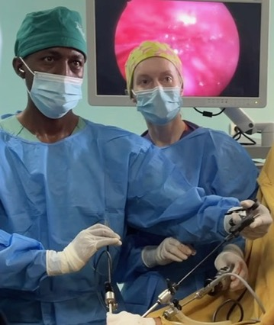
APSA Global Pediatric Surgery Committee
Chair: Robin Petroze (Michigan)
Vice-Chair: Monica Langer (Boston)
Mission:
to develop partnerships with overseas colleagues to facilitate the exchange of information and resources
to advocate and encourage responsible international service and surgical education by APSA members and trainees
to facilitate the educational opportunities of surgeons caring for children in resource-limited settings
to identify and support areas of research relevant to pediatric surgical care in resource-limited settings.
Our vision is to promote access to optimal surgical care for children throughout the world and aim to identify partners in resource-limited settings.
Subcommittee structure
ACS H.O.P.E. Collaboration
Global Surgery Scholarship
Annual Meeting
Notes:
Thank you for the opportunity to present on behalf of the Global Pediatric Surgery Committee. I’m thrilled to step into the chair role this year and am grateful to Jay Krishnaswami on his leadership the past two years. I am very excited to welcome Monica Langer as Vice Chair and a really diverse and engaged committee, including seasoned global surgeons, international partners, and trainees with a passion.
I always like to provide a reminder of the committee’s mission and vision as we discuss the committee’s activity, and I think the past year and current activities really allow us to focus on partnership, education, and opportunity.
Today (and not in this order) I’m going to briefly discuss our subcommittee structure to give an idea of broad activities and then focus on the ACS HOPE Collaboration, the Jim O’Neill Global Surgery Scholarship, and the Annual Meeting. The QR code here should provide a link to a video made by one of our members, Heron Baumgarten, and shown at last year’s meeting as an overview of one of the ACS HOPE opportunities in Ethiopia.

Slide 2
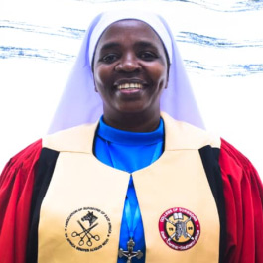
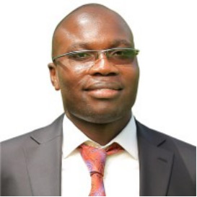
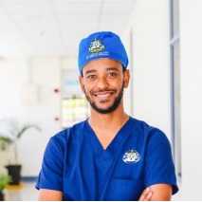
APSA Global Pediatric Surgery Committee – 2024 Initiatives
Jim O’Neill Global Pediatric Surgery Scholarship – 2024 Awardees
~40 applications
Multiple reapplications
Dr. Alicia Massenga
Buganda Medical Centre, Tanzania
“Emergent Management and Transfer of Gastroschisis Patients in Northern Tanzania: Referral Survey, Toolkit development, and Implementation Assessment”
Dr. Felix Oyania
Mbarara University of Science and Technology, Uganda
“Stepwise Intervention to Improve Mental Health and Inclusion for Children with Stomas in Uganda”
Committee-sponsored Annual Meeting Content
Research Abstracts
Judah Folkman Award
Breakout Session-”Global Surgery Engagement Opportunity: APSA/ACS Partnerships for Pediatric Surgical Education”
Breakshop session: “International Rotations for Ped Surg Fellows: Obstacles/Opportunities/Successful Launches”
Don Meier Humanitarian Award (2024) Dr. Sherif Emil
Muse Freneh Anito MD, BethanyKids Kijabe Hospital, Kijabe, Kenya
Addressing the Problem of Pediatric Central-line Associated Blood Stream Infections at a Rural Referral Hospital in a Low-middle Income Country”
Notes:
Continuing the Global Pediatric Surgery Research Grant was one of our biggest items the past year. The QR code here provides a link to the scholarship page and details on the application and past winners. The application cycle will hopefully run with the Grosfeld and other foundation awards, so if you have colleagues, have them check the site and announcements in December. We had many, many more applications for this grant than any other foundation award, and I was so thrilled with the innovation and caliber of these projects. Many were reapplicants, and the biggest problem with this award is that we don’t have the opportunity to award more. The two winners presented very robust and unique proposals for big pediatric surgical problems in low-resource settings. Sister Massenga from Tanzania will be working on improving the management and transfer of gastroschisis patients, and Dr. Felix Oyania from Uganda has a fascinating project looking at mental health and inclusion for stomas in children.
This year, we were thrilled to see that one of the Judah Folkman presentation winners was not just a global abstract, but an international pediatric surgery trainee, Dr. Muse from Kijabe who presented on central-line associated blood stream infections in Kenya. These three projects really highlight the incredible work and deep challenges for pediatric surgeons globally.
The committee sponsored a breakout session on the ACS H.O.P.E. partnership and a breakshop on the logistics of international rotations for pediatric surgery fellows, an opportunity that is now approved by the ACGME/ABS.
And finally, we congratulate Dr. Sherif Emil for being awarded the Done Meier Humanitarian Award this past year.

Slide 3
APSA Global Pediatric Surgery Committee – Current Focus, Challenges and Needs
Global Surgery Research Grant
ACS H.O.P.E.
APSA Sponsors
Feedback
2023 Awardee Reports
Hawassa, Ethiopia
Lusaka, Zambia
Recruitment
Model for Expansion
Education
Broad access to NAT
Modules, Simulation
More, more, more
NAT LMIC perspectives
Lecture Series (?)
APSA/ACS H.O.P.E. Hawassa Video
Member Engagement
Internal APSA Cross-Committee Engagement
External APSA Cross-Committee Engagement
Needs for APSA membership
Career paths/mentoring
Potential Joint Content
Global is Local
Innovation is Global
Quality, Equity, Diversity, Rurality . . .
GICS, AAGS, ACS
International Memberships
Joint CAPS Annual Meeting content
Global Surgery Scholarship
probin@med.umich.edu
Monica.Langer@childrens.Harvard.edu
Notes:
Global Surgery Grant: The APSA Foundation now offers $5000-$25000 research grants to surgeons from LMIC (with APSA member sponsors). Members of this subcommittee will likely be part of a review committee with APSA foundation board members and LMIC surgeons as well as facilitate LMIC surgeons in finding mentors, when needed. They will also be in charge of evaluating the grant process and providing feedback to applicants as well as coordinating the report back of the first recipients.
https://apsapedsurg.org/apsa-info/apsa-foundation/global-research-scholarship/
ACS H.O.P.E.: ACS H.O.P.E., the international outreach arm of the American College of Surgeons has asked APSA to partner with them for educational efforts in their partnership with training institutions in East Africa. We have a formal MOU with ACS to help with providing pediatric surgical education content for general surgery residents and eventually up to quarterly visits from pediatric surgeons, which the committee would help to vet and coach/mentor/guide as needed. The two current hubs are in Hawassa, Ethiopia, and Lusaka, Zambia. For this subcommittee, members would attend virtual education meetings with each hub and work on structuring future surgeon (and potential fellow) visits. There is likely a decent amount of overlap with the education subcommittee.
Education- the Education subcommittee has a lot of opportunity for innovation and ideas! While there will be significant overlap with other committees, the primary aim of this subcommittee is to work on “internationalizing” existing educational content. What this means is a) publicizing and promoting the initiative to provide NAT free (or nominal $20 fee) to LMIC surgeons and trainees, b) add global surgical content to existing NAT content, ideally by partnering with LMIC surgeons to provide research and/or perspectives from diverse settings around the globe, and updating our committee pedsurglibrary resource as appropriate.
Member Engagement- one of the primary goals of an APSA committee is to serve the membership. This subcommittee will work on identifying the needs as relates to global surgery amongst the APSA membership that APSA can do a better job of supporting and for which we may be able to create some resources. This may include candidate and junior members looking to incorporate global surgery into their career via retiree members engaging globally. Ideally, there would be opportunity to liaise with other APSA committees, including developing joint content for the annual meeting.
Internal APSA Cross-Committee Engagement - Members of this subcommittee will specifically look for ways to partner with other APSA committees. Some ideas include a global surgery-focused e-blast or partnering with technology or industry committees for building relationships with vendors for global support. The ASK APSA committee also has overlap in addressing rural access to pediatric surgery, for example.
External APSA Cross-Committee Engagement - Members of this subcommittee will liaise with external societies/organizations (examples AAGS, GICS, etc). They will also look at ways to promote or increase international APSA membership.

